Slide 1
ANALYSIS ON PRODUCT SALES,CUSTOMER RELATIONSHIPS,SUPPLIER ANALYSIS, FORECASTING AND PROFITABILITY OF TRADING COMPANY
BY
ADETUNJI, Babajide Samuel
ALT/SOD/023/0525

Slide 2
DATABASE OVERVIEW
NORTHWIND DATABASE
The Northwind Database consists of 11 tables and different columns. The tables used in the analysis are Categories, Customers, EmployeeTerritories, Employees,OrderDetails,Orders,Product,Region,Shippers, suppliers and Territories ,all are connected by their different ID’s and each tables are important as the other in the analysis.

Slide 3
METHODOLOGY AND STEPS TAKEN FOR DATA EXPLORATION AND ANALYSIS
The approaches used for this analysis are Python, SQL and PowerBI, and they’re explained below;
SQL: For data manipulation,extracting tables and cleaning data.
Python(Google colab): For data cleaning, data visualization(using matplotlib and seaborn) and data analytics.
PowerBI: For data cleaning and data visualization.

Slide 4
OBJECTIVES OF THE STUDY
Top Customers by Sales: Identify customers generating the highest sales and analyze their order patterns and preferences.
Product Performance: Analyze the performance of different products, including sales trends, profitability, and seasonal effects.
Order Trends: Evaluate order trends over time, including the impact of promotions and external events.

Slide 5
Supplier Analysis: Assess the performance and reliability of suppliers based on delivery times, product quality, and order fulfillment rates.
Sales Forecasting: Use time series analysis to forecast future sales and identify potential growth opportunities.
Profitability Analysis: Analyze the profitability of different product lines and customer segments, and provide recommendations for improving margins.

Slide 6
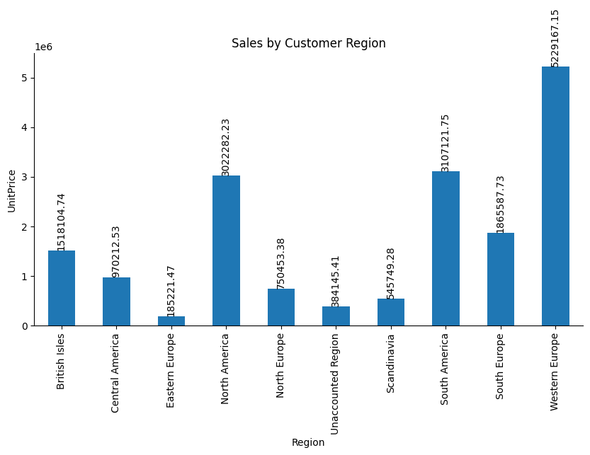
DATA ANALYSIS
1.0
Top customers by sales

Slide 7
Customer sales by region shows that region with the highest sales are South Americans and second highest are the North Americans as seen in the visualization (fig1.0) .
It is seen in the visual (fig1.1) below that customers in the western europe region prefer to order through ships 1,2 and 3 as they have the highest orders in these ships ,followed by the south americans.

Slide 8
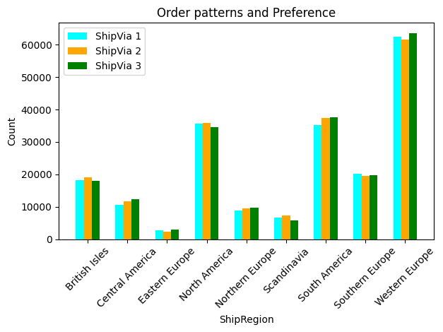
1.1

Slide 9
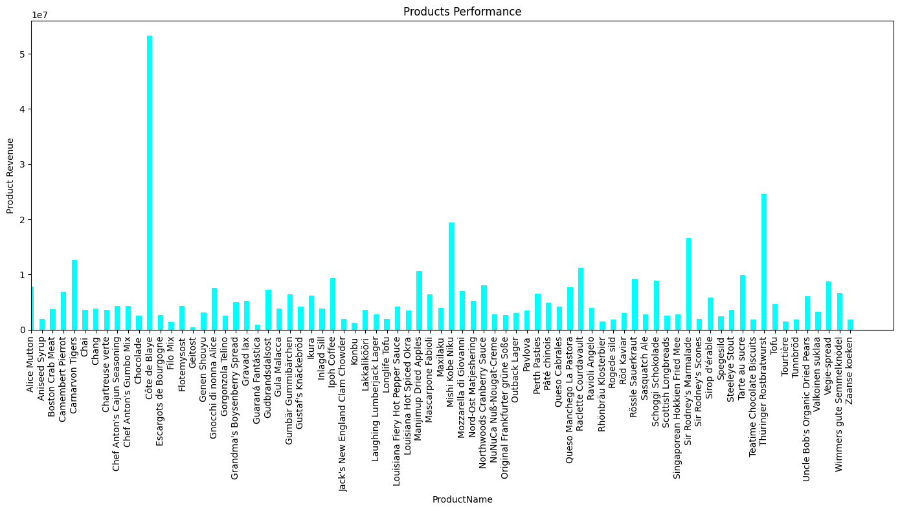

Product Performance
1.2

Slide 10
The Product performing best as seen in the visual (fig1.2) above is the Cote de Biaye and we can also see the performance of the other products as well.
Further analysis to check the products performance over time ,profitability and seasonal effects.

Slide 11
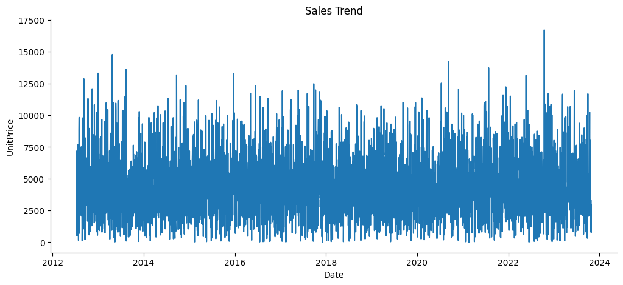
1.3

Slide 12
Augmented Dickey-Fuller Test:
ADF test statistic -63.747229
p-value 0.000000
# lags used 0.000000
# observations 4052.000000
critical value (1%) -3.431965
critical value (5%) -2.862254
critical value (10%) -2.567150
Strong evidence against the null hypothesis
Reject the null hypothesis
Data has no unit root and is stationary

Slide 13
Performed the Augmented Dickey-Fuller Test to check the Stationarity of the time series analysis 1.3 and its shows that the data has no trend and seasonality.
Product Profitability(fig1.4) shows that Cote De Biaye also makes the highest profits amongst other products .
Also checked the Product Seasonality Effect(fig1.5), As the data is stationary(has no trend or seasonality) we couldn’t really figure the months that performed well but from our visualization below we can see sales went up around May, between June/July, August and December.

Slide 14
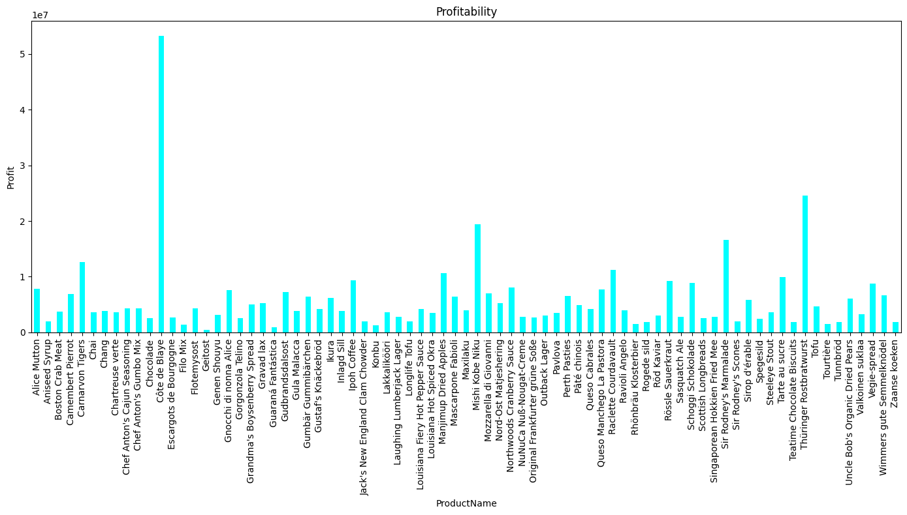
1.4
Notes:
‹#›

Slide 15
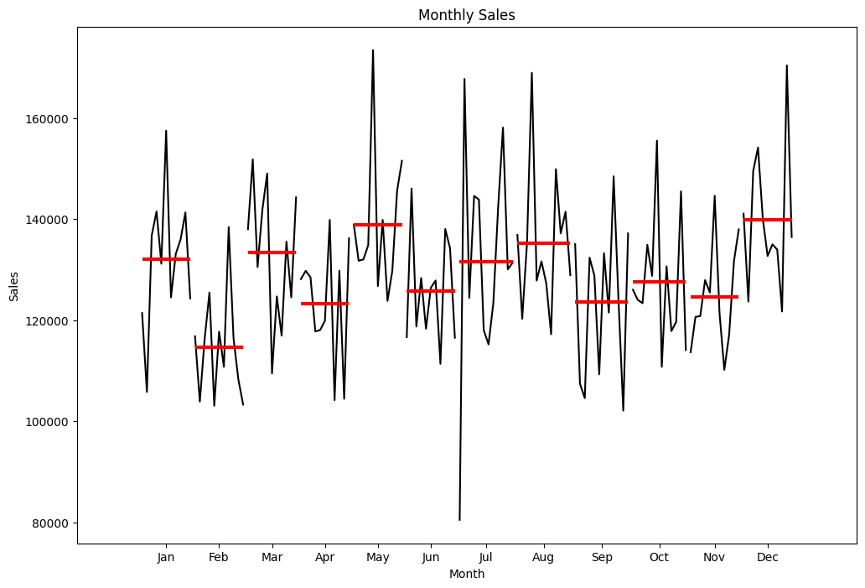
1.5

Slide 16
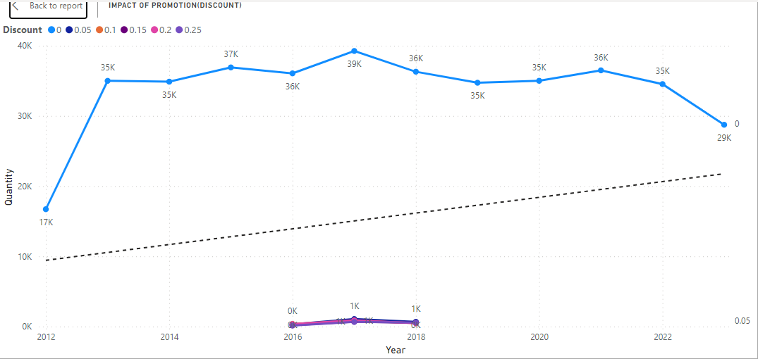
Order Trend with exorgenous variables Promotion(Discount) and External Events(Discontinued)
1.6
Time series analysis above shows that even though sales peaked when promotion was introduced ,it didn’t affect sales positively for long as there is a downward trend after the peak.

Slide 17
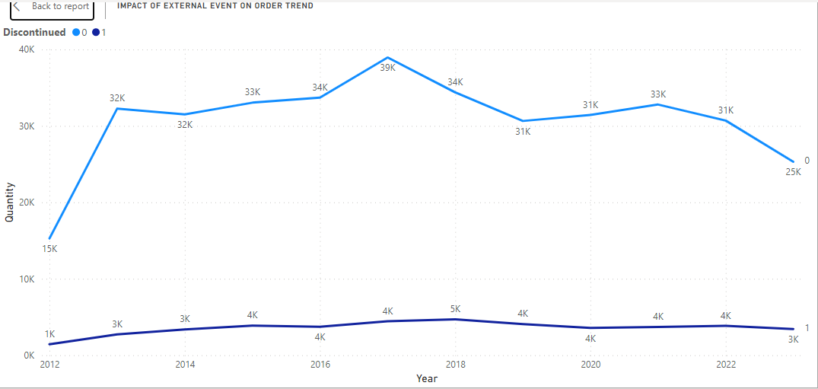
1.7
Discontinued products’ sales doesn’t really have much effect on total sales ,the sales of discontinued products are extremely low as they do not have much effect on the trend of sales.

Slide 18
SUPPLIER ANALYSIS
Average Delivery times By Suppliers
Supplier ID | Delivery Times | SupplierID | Delivery Times
1 | 7 days 20:24:05.064166842 | 16 | 7 days 19:26:55.204436198
2 | 7 days 18:12:09.702266700 | 17 | 7 days 20:10:17.531094422
3 | 7 days 20:04:06.443233462 | 18 | 7 days 20:02:00.054490413
4 | 7 days 19:44:53.909919412 | 19 | 7 days 18:47:19.933114173
5 | 7 days 20:21:35.880816894 | 20 | 7 days 19:55:39.927867326
6 | 7 days 19:20:26.795470808 | 21 | 7 days 18:55:25.230715465
7 | 7 days 19:16:29.921648859 | 22 | 7 days 18:51:48.340626395
8 | 7 days 19:38:21.595361312 | 23 | 7 days 20:33:51.897795760
9 | 7 days 18:29:17.086453882 | 24 | 7 days 20:27:42.980706579
10 | 7 days 19:48:51.548039091 | 25 | 7 days 18:38:52.172127016
11 | 7 days 20:34:54.301437216 | 26 | 7 days 20:58:19.201085927
12 | 7 days 19:42:38.725146050 | 27 | 7 days 19:46:57.492603363
13 | 7 days 19:08:32.113947931 | 28 | 7 days 18:59:37.839180183
14 | 7 days 18:57:33.786458992 | 29 | 7 days 20:06:31.068633012
15 | 7 days 20:02:58.538913856

Slide 19
There is an average of 7days delivery time amongst all suppliers. This goes to show that they are reliable when it comes to delivering product.
In the visual(fig1.8) ,i used the UnitsInStock and compared it to the suppliers to check the performance of the suppliers as it reflects inventory levels. If instances where UnitsInStock reaches zero or critically low levels, indicates potential issues with supplier reliability or Order fulfillment.

Slide 20
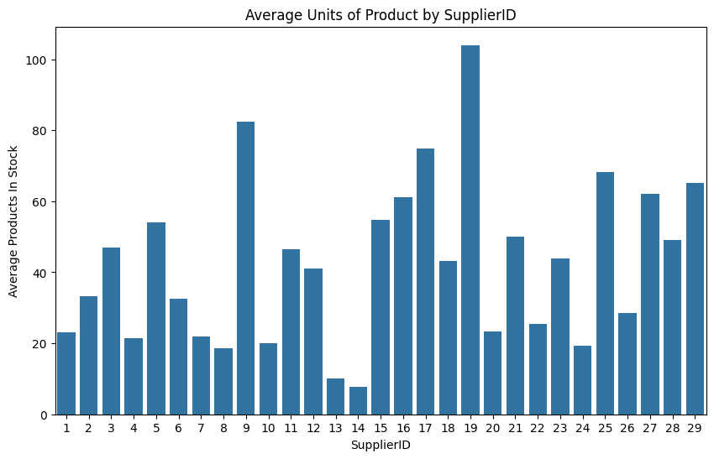
1.8

Slide 21
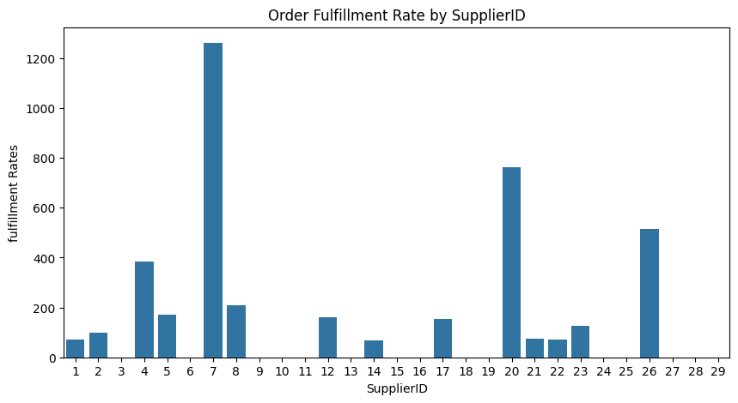
1.9
Suppliers with a fulfillment rate greater than 100% delivered more units than ordered.
Suppliers with a fulfillment rate less than 100% delivered fewer units than ordered.
An infinite fulfillment rate indicates a discrepancy in order records where units were delivered without corresponding orders

Slide 22
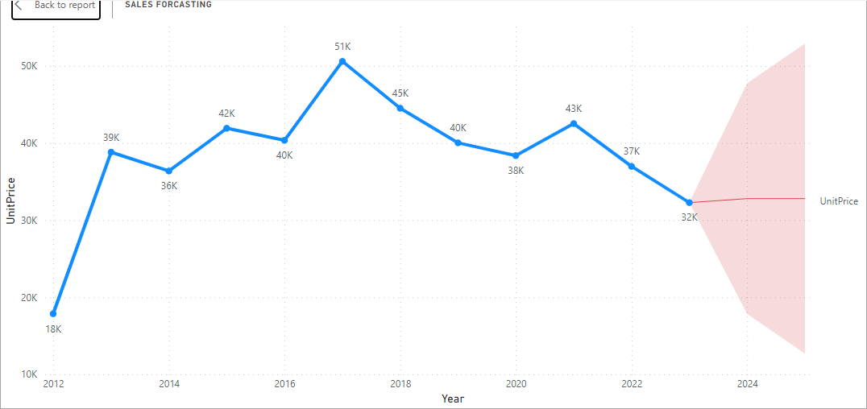
2.0
I used time series to forecast future sales. The red shaded area is the sales from Nov, 2023 to oct, 2025 (24months) forecast ,from the trend line we can see that there’s no upward or downward trend ,neither is there seasonality. There’s chance for potential growth if we focused more on region with higher sales and add more promotion to attract customers.

Slide 23
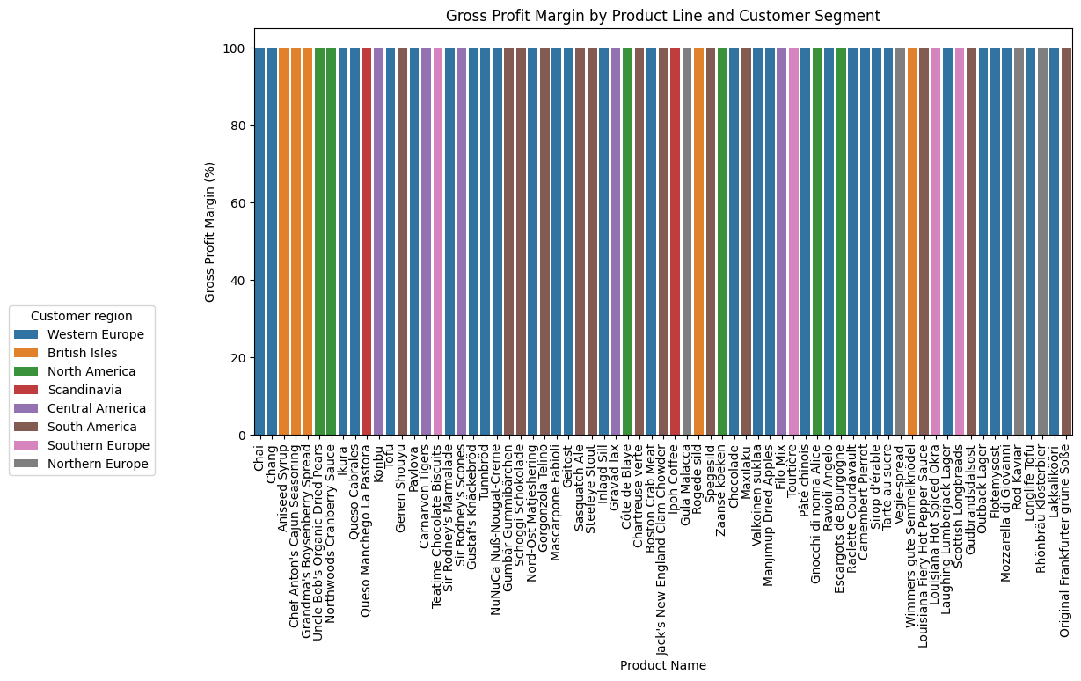
2.1

Slide 24
There’s a gross profit of 97% - 99% across all products in their regions asides discontinued products.

Slide 25
CONCLUSION
We need feedbacks from the customers to know the steps and what to work on.
We add a comment section where customers can relay complaints or reasons to understand why certain products aren’t performing well in regions.
We need understand our customers more to find seasons when products can thrive.
We need to also work more on promotion like advertisement, discounts, promos, etc.
Better record keeping for more better analysis.

Slide 26
THANK YOU

